Slide 1

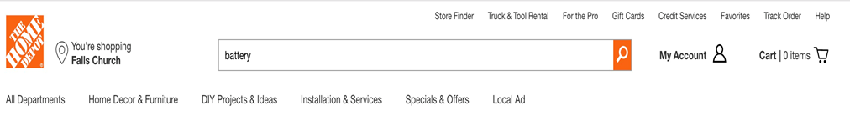

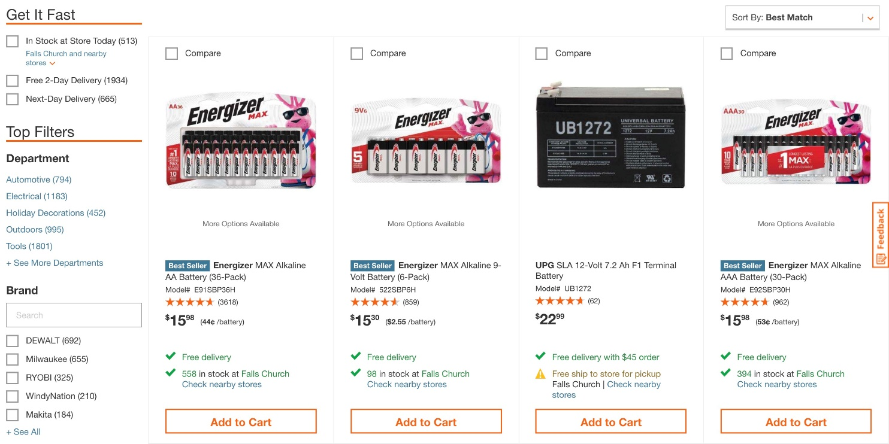
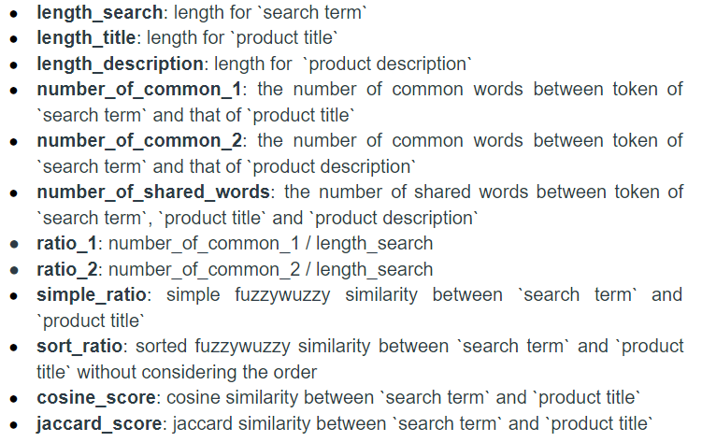
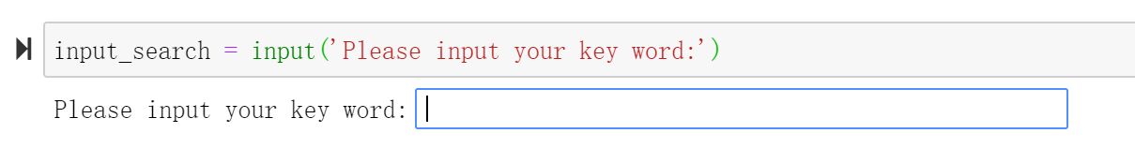
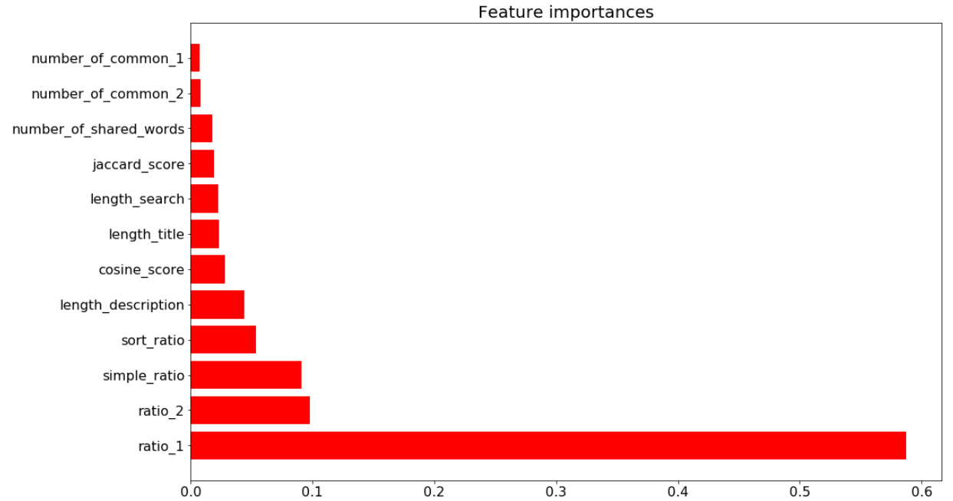
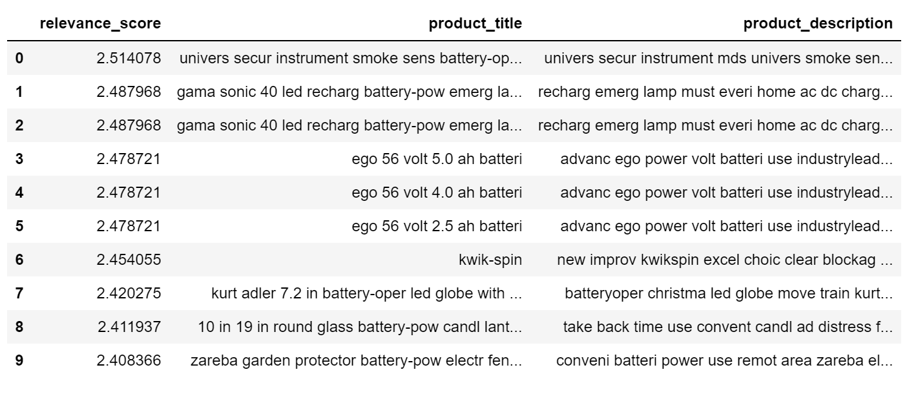
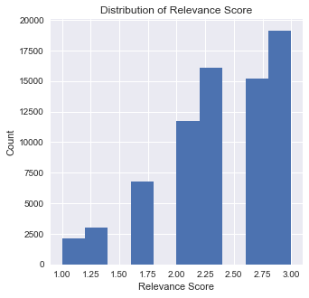
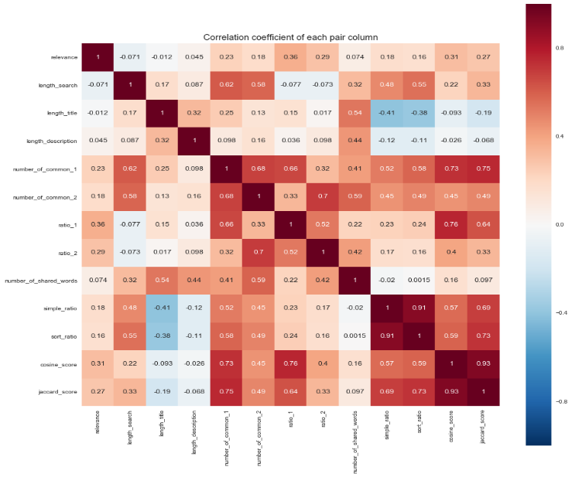
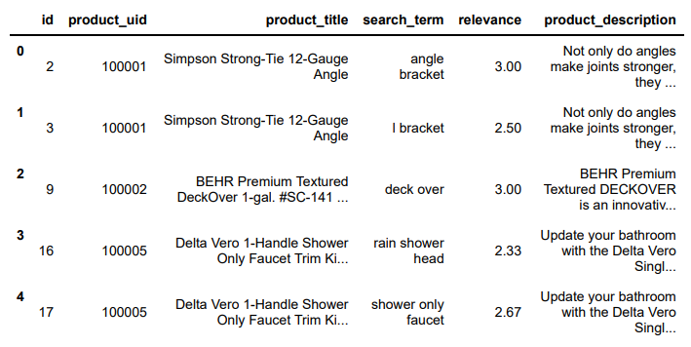
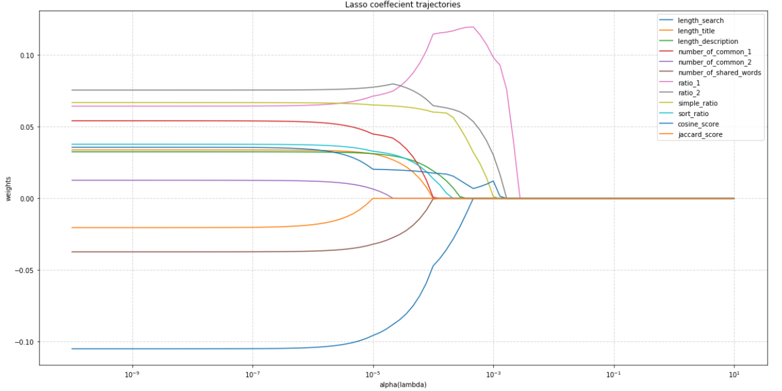
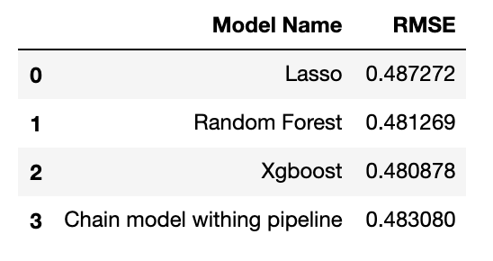
Home Depot Product Search Relevance
400 Bad Request - Hongyang Zheng, Heng Zhou, Zhengqian Xu
Georgetown University
INTRODUCTION
ANALYSIS
Random Forest:
For this model, we used GridSearchCV to find the best parameters. We set max_depth as [5,6,7] and n_estimators as [200,400,600], then got the optimal parameters with max_depth at 7 and n_estimators at 400. Here is the feature selection visualization.
APPLICATION
Feature Engineering
We create 12 numerical variables as following:
Ask the user to input a search term: battery
Recalculate the new features
Apply the best model Xgboost to the new data
Get the products with the top 10 relevance score
When a customer wants to buy something online, he/she might not be able to input the exact name for that product, and the company needs to figure out which products are most relevant to the search words in order to return the high relevant products to that customer.
Based on that scenario, our group first predicted the relevant score between what a user enters (keywords) and what the company has (products) by building supervised machine learning models with NLP techniques. And then on the top of our best model, we developed a mini search recommendation application to return the top 10 high relevant products in the database given a keyword.
Exploratory Data Analysis
Xgboost:
We also used GridSearchCV to find the best parameters. We set max_depth as [2,4,6,8] and n_estimators as [20,50,100,200]. Then got the optimal parameters with max_depth at 4 and n_estimators at 100.
Chain model with pipeline:
We picked two best models - Random Forest and Xgboost, from the previous three models and built a pipeline to fit the training data.
CONCLUSION
Our project starts from feature engineering, model building, and finally developed a mini search recommendation application. Most of the products are related to the keyword, but there are still some unrelated products. However, since we only used a subset from the original data, this result is better than what we expected at the beginning.
Model Building
We built four models by using 12 new created numerical variables to predict relevance score.
Lasso:
It helps to make an automatic feature selection. We first made a trajectory plot of lasso coefficients and then used LassoCV to choose best parameter to fit the training data.
RESULTS
DATA
From the previous results, we can see that ratio_1 and ratio_2 are the top two important variables. Also, we use RMSE as our evaluation metrics and find our best model is Xgboost with test RMSE = 0.48. Compared with the best RMSE score 0.43 in Kaggle competition leaderboard, our result is pretty good since we trained our model based on a smaller dataset.
Data and Features
Train data: id, product_id, product_title, search_term, relevance
Descriptions: product_description
REFERENCES
[1] Petar R. Petar P., Peter M., Heiko P.: A Machine Learning Approach for Product Matching and Categorization(2016)
[2] Petrovski, P., Bryl, V., Bizer, C.: Learning regular expressions for the extraction of product attributes from e-commerce microdata (2014)
[3] Ghani, R., Probst, K., Liu, Y., Krema, M., Fano, A.: Text mining for product attribute extraction. ACM SIGKDD Explorations Newsletter 8(1), 41–48 (2006)
[4] Le, Q.V., Mikolov, T.: Distributed representations of sentences and documents. arXiv preprint arXiv:1405.4053 (2014)

